Slide 1


Designing Apache Cassandra Database schema
UNIVERSITY OF NORTH TEXAS
DEPARTMENT OF COMPUTER SCINCE AND ENGINEERING
Presented by :PERUMALLA SRINU
Id :11750704
CSCE 5300
Instructor: prof. kumara Jayantha Muthukudage

Slide 2
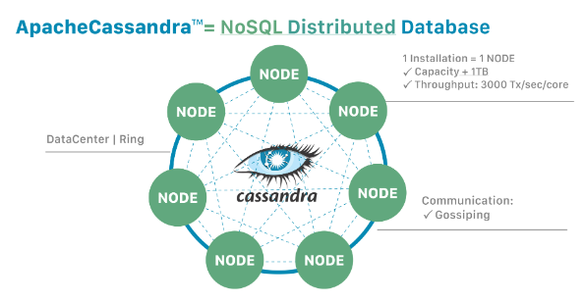
Apache Cassandra is a distributed NoSQL database system that can handle large amounts of data across many commodity servers. It is known for its scalability, fault tolerance, and high availability.
Cassandra is designed to be distributed, meaning it can easily scale to accommodate more data by adding more servers to the cluster. It is used for applications that require fast reads and writes on a large scale, such as social media platforms, messaging apps, and IoT systems.
INTRODUCTION TO APACHE CASSANDRA DATA BASE DESIGN

Slide 3
Apache Cassandra:
Database Design and Schema Creation for the social media application: FACEBOOK
Creating facebook keyspace:
This query creates a keyspace named "facebook" using SimpleStrategy with a replication factor of 1, meaning that there will be only one copy of each data item:
Creating Tables:
1.USERS TABLE:

Slide 4
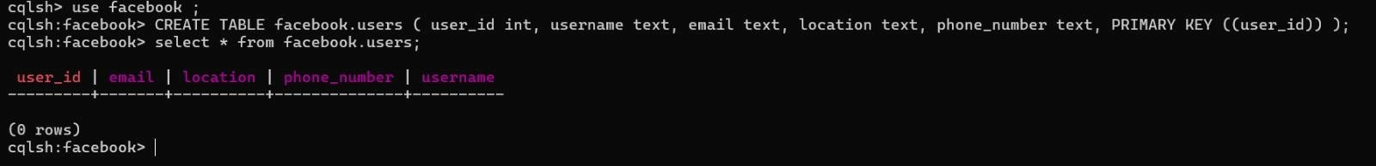
Partition Key: user_id is chosen as the partition key as it provides a unique identifier for each user and evenly distributes data across nodes.
This table is designed to store basic user information, and the primary key user_id uniquely identifies each user. Since the queries mentioned don't involve range queries on user attributes, no clustering columns or secondary indexes are necessary.

Slide 5
2.POSTS TABLE:
Partition Key: user_id is chosen as the partition key as it provides a unique identifier for each user and evenly distributes data across nodes.
Clustering Columns: post_id is chosen as the clustering key as it provides to uniquely identify each post within a user posts
This table is designed to store posts made by users. Grouping by user_id allows for efficient retrieval of all posts by a user. The clustering column post_id ensures each post is uniquely identified within a user's posts.

Slide 6
3.COMMENTS TABLE:
Partition Key: post_id (to group comments by post)
Clustering Columns: comment_id (to uniquely identify each comment within a post)
This table is designed to store comments on posts. Grouping by post_id allows for efficient retrieval of all comments on a post. The clustering column comment_id ensures each comment is uniquely identified within a post's comments.
Choosing the appropriate partition key is crucial for efficient data distribution and query performance. It should be based on the most frequent access patterns of your application.
Clustering keys determine the sorting order of data within a partition. Selecting the right clustering keys can significantly improve query performance

Slide 7
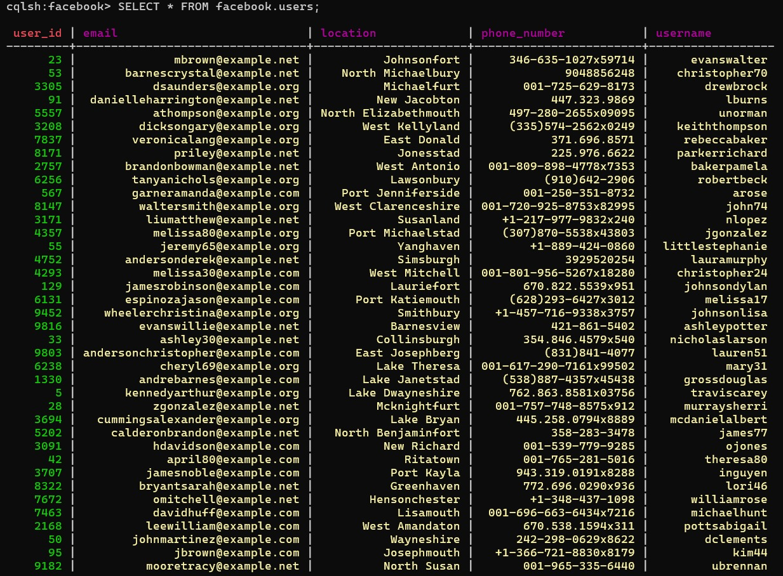
2.Data Modeling and Population:
Populate the Cassandra database with sample data.
By using FAKER library I am Generated the synthetic data
USERS TABLE:
using faker library I am Generate synthetic data for facebook.users database schema.

Slide 8
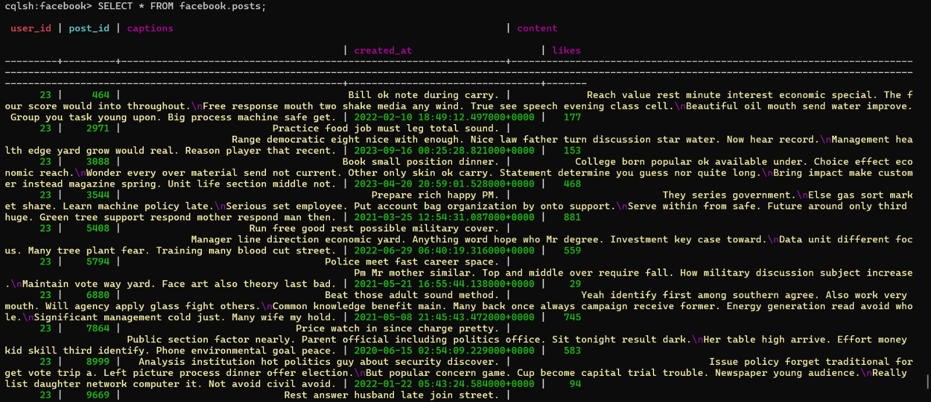
POSTS TABLE:
using faker library I am Generate synthetic data for facebook.posts database schema.

Slide 9
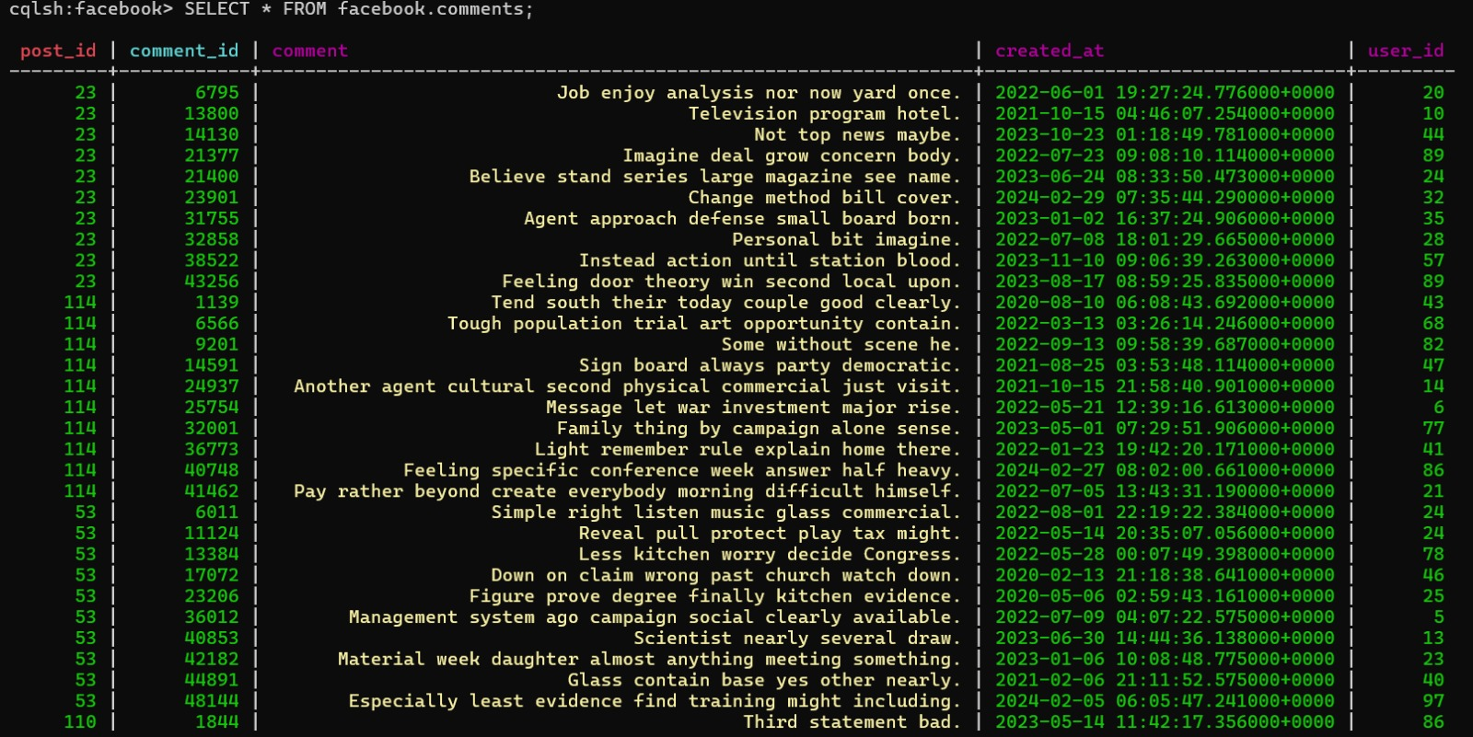
COMMENTS TABLE:
using faker library I am Generate synthetic data for facebook.comments database schema.

Slide 10
CREATING DENORMALISED TABLE:
For the facebook.d_posts table:
Partition Key: user_id is used as the partition key to distribute data evenly across nodes and allow efficient retrieval of posts for a specific user.
Clustering Key: post_id is used as the clustering key to maintain the order of posts within each user's partition.
Secondary Indexes: Secondary indexes on username, created_at, likes, and captions are used to support common query patterns for retrieving posts based on these criteria.
These design decisions align with the use case scenario by providing efficient retrieval of posts for a specific user and supporting common query patterns for post retrieval.

Slide 11
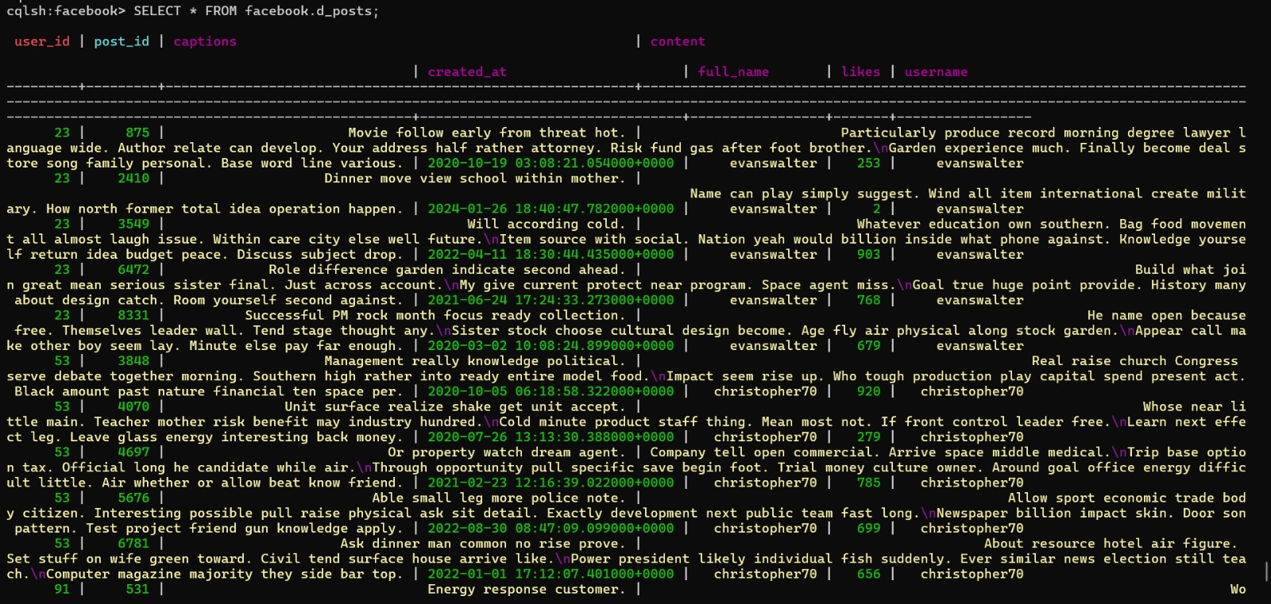
d_posts Denormalized table:

Slide 12
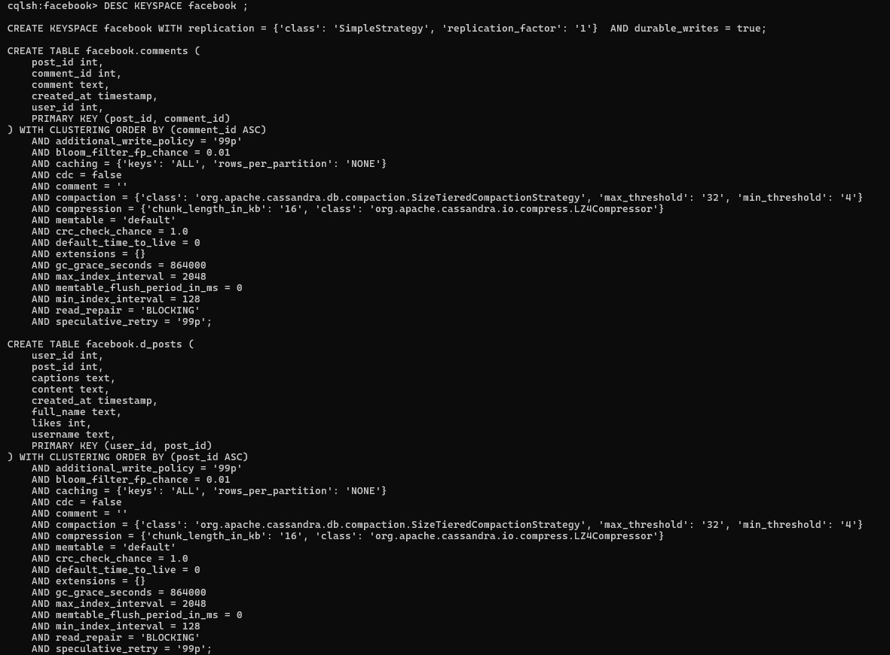
DESCRIBE FACEBOOK:

Slide 13
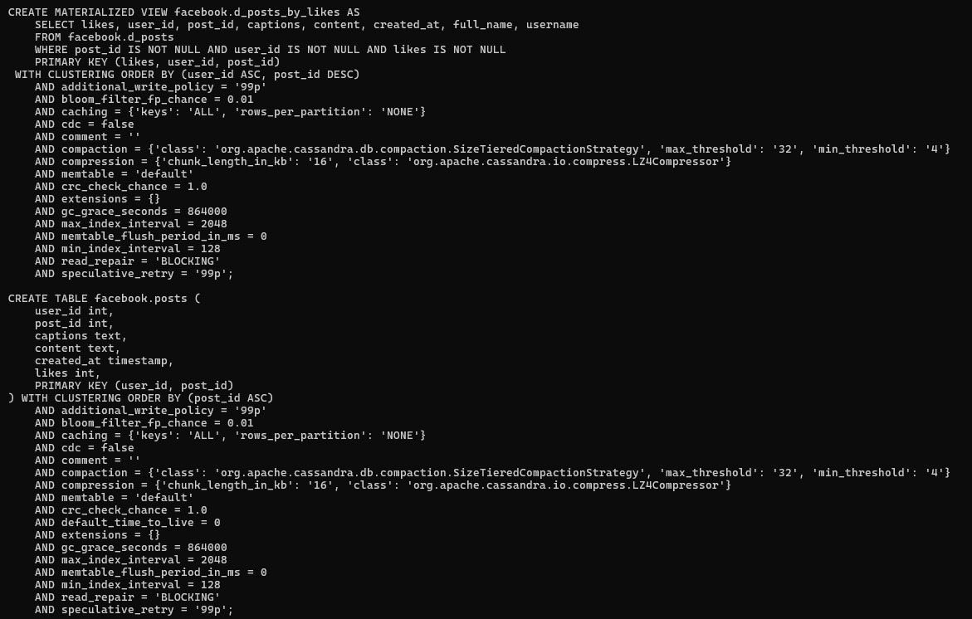

Slide 14
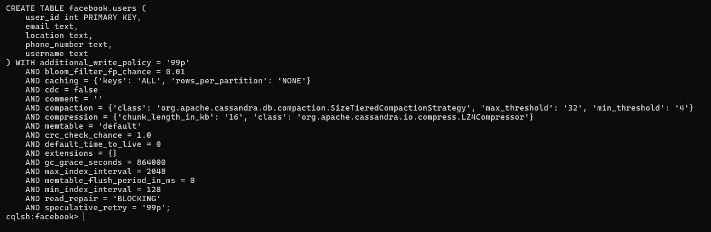

Slide 15
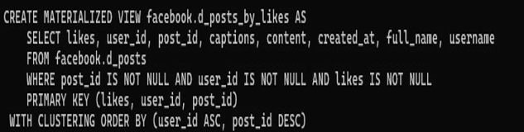
MATERIALIZED VIEWS:
Materialized views are precomputed views that store the results of a query. They are useful for improving query performance by reducing the need to compute the same results repeatedly.
In Cassandra, materialized views are created using the CREATE MATERIALIZED VIEW statement.
Here's an example of how you might use materialized views for the facebook.d_posts table:

Slide 16
For the `facebook.d_posts_by_likes` materialized view:
Partition Key:`likes` is chosen as the partition key to evenly distribute posts based on their popularity.
Clustering Keys: `user_id` and `post_id` are chosen as clustering keys to efficiently retrieve posts for a given user and sort them by post ID.
Secondary Indexes: Consider adding secondary indexes on fields like `full_name`, `username`, or `created_at` if needed for specific query requirements.

Slide 17
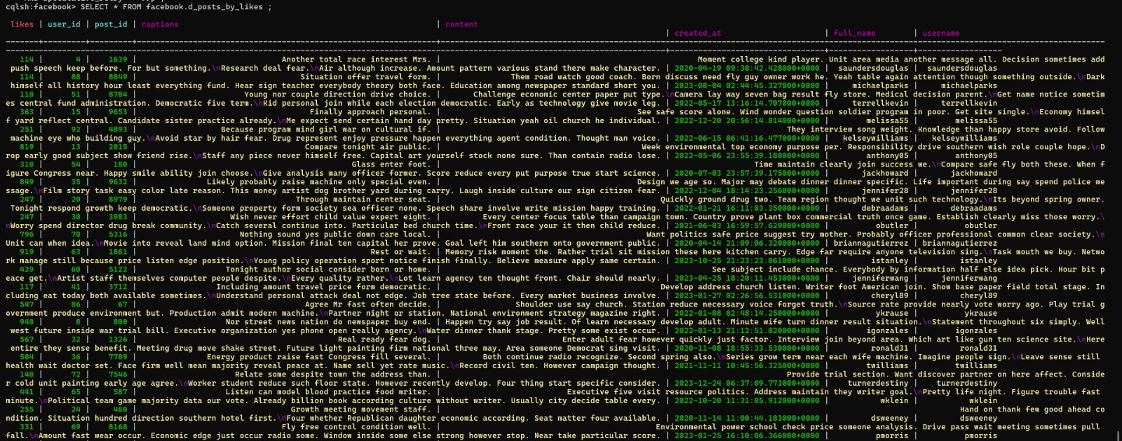
For materialized view we have to enable it the materialized view in ubuntu:

Slide 18
COLLECTIONS:
In Cassandra, collections are used to store multiple values within a single column. There are three main types of collections:
Lists: Ordered collections of elements. Useful when the order of elements matters, like storing comments on a post.
Sets: Collections of unique elements. Useful when uniqueness is important but the order doesn't matter, like storing tags for a post.
Maps: Collections of key-value pairs. Useful for storing data with unique keys, like user preferences.
Collections can help optimize data storage and retrieval by reducing the need for joins in queries. However, they should be used judiciously to avoid performance issues.
Creating collections for Post as “post_collections”:

Slide 19
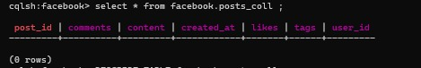
Partition Key:The `post_id` field is used as the partition key to uniquely identify each post. This ensures that each post is stored on a single node for efficient retrieval.
Clustering Keys:No additional clustering keys are needed since `post_id` is already the partition key. Clustering keys are used to order rows within a partition, but in this case, the unique `post_id` already provides the desired ordering.
Secondary Indexes: Secondary indexes should be added based on anticipated query patterns. For example, you might add a secondary index on the `user_id` field if you frequently query posts by user.
These design decisions align with the facebook by ensuring efficient storage and retrieval of posts, while also allowing for flexible querying based on different criteria.

Slide 20
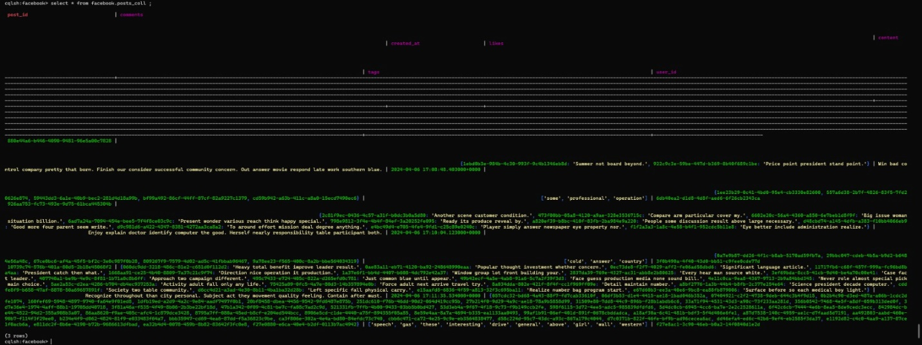
Facebook.post_collections:

Slide 21
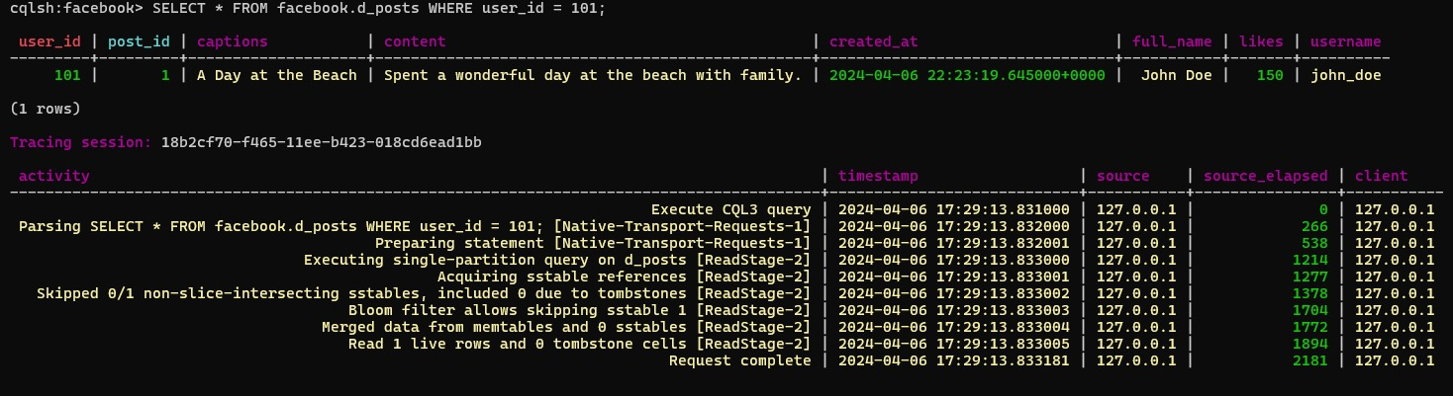
3.Query Optimization and Performance Tuning:
FOR DENORMALISED TABLE
Read-heavy query: In Cassandra, a read-heavy query typically refers to a query pattern where there are more read operations (SELECT queries) compared to write operations (INSERT, UPDATE, DELETE queries)

Slide 22
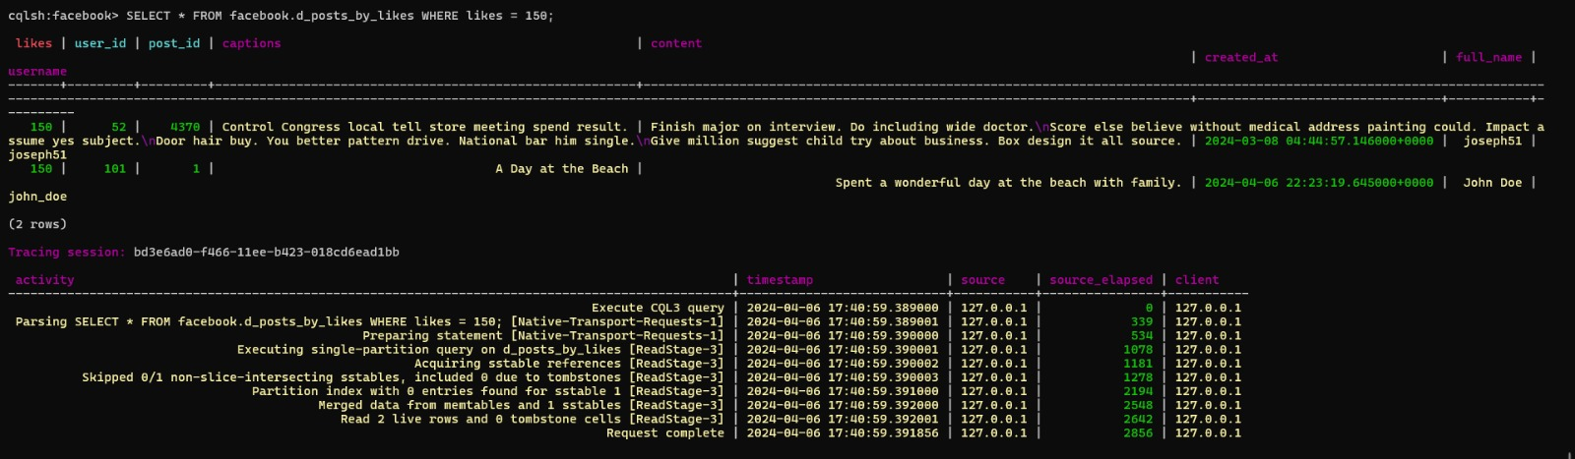
For materialized view

Slide 23
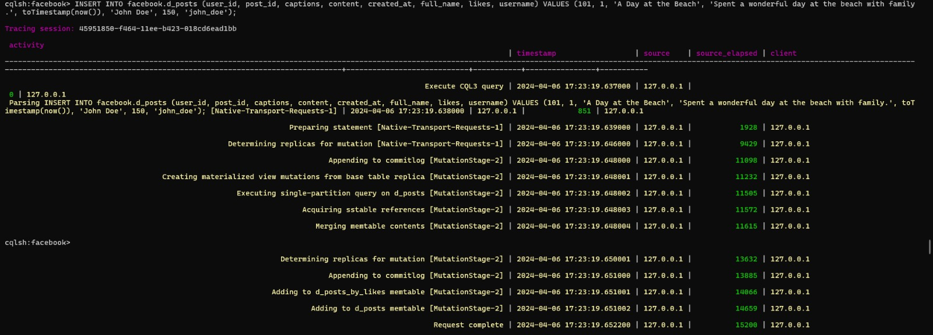
write-heavy queries for denormalised view:

Slide 24
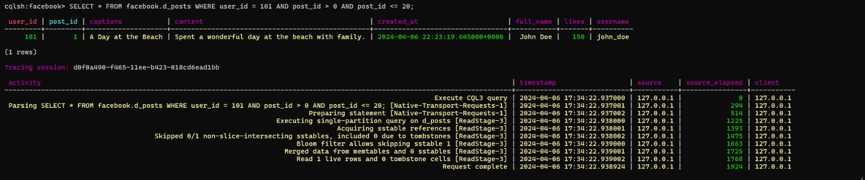
RANGE QUERIES FOR DENORMALISED VIEW TABLE:

Slide 25
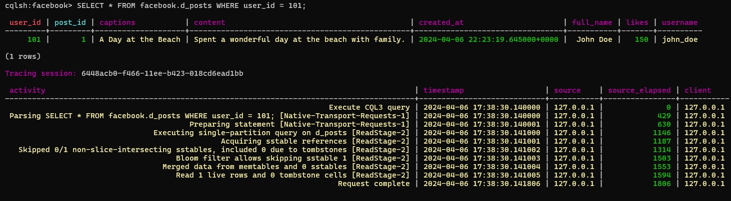
FILTERING FOR DENORMALISED VIEW TABLE
Partition key

Slide 26
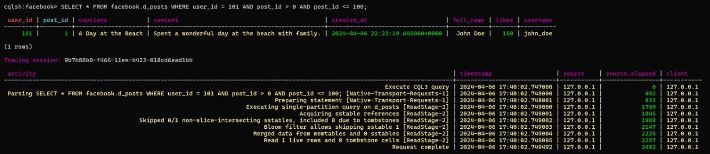
Clustering key

Slide 27
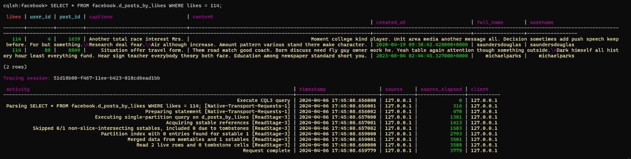
FOR MATERIALISED VIEW :
PARTITION KEY

Slide 28
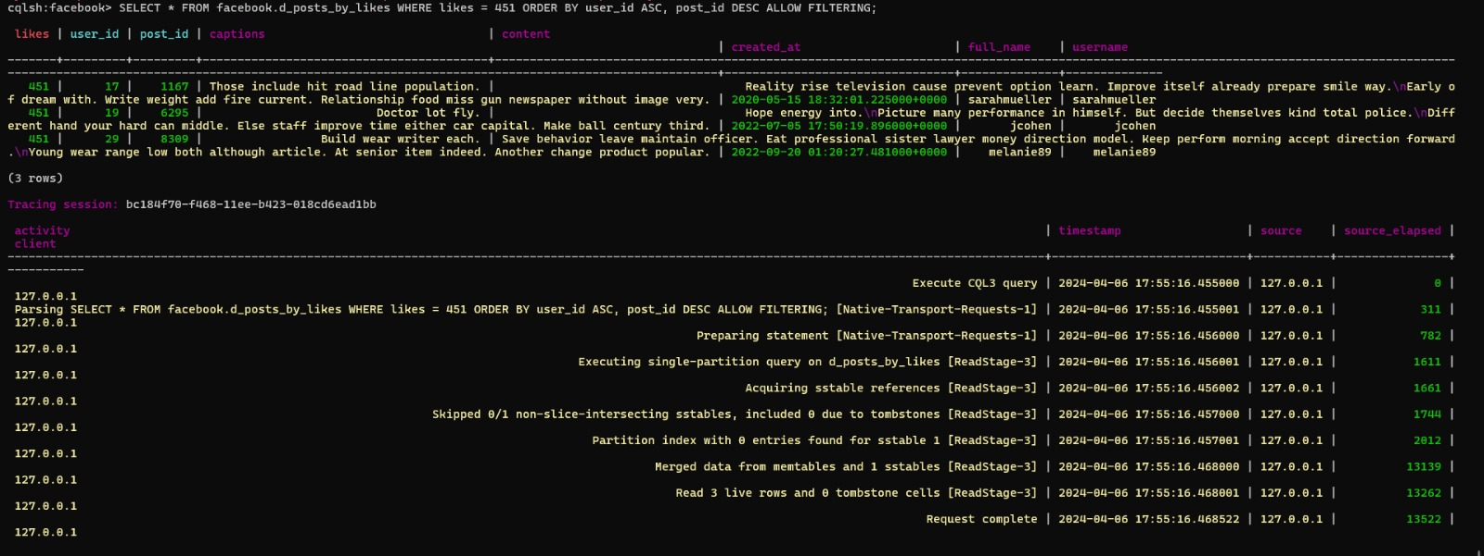
CLUSTER KEY:

Slide 29
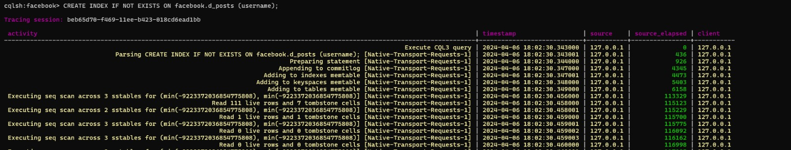
INDEXING FOR DENORMALISED VIEW TABLE:

Slide 30
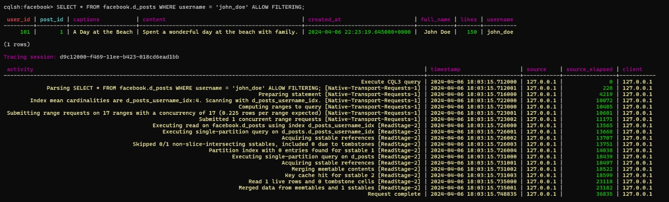

Slide 31
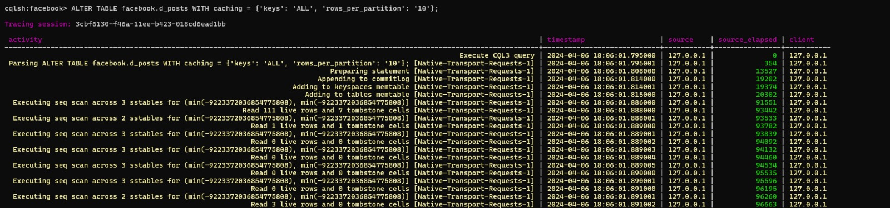
CACHING DENORMALISED VIEW TABLE:

Slide 32
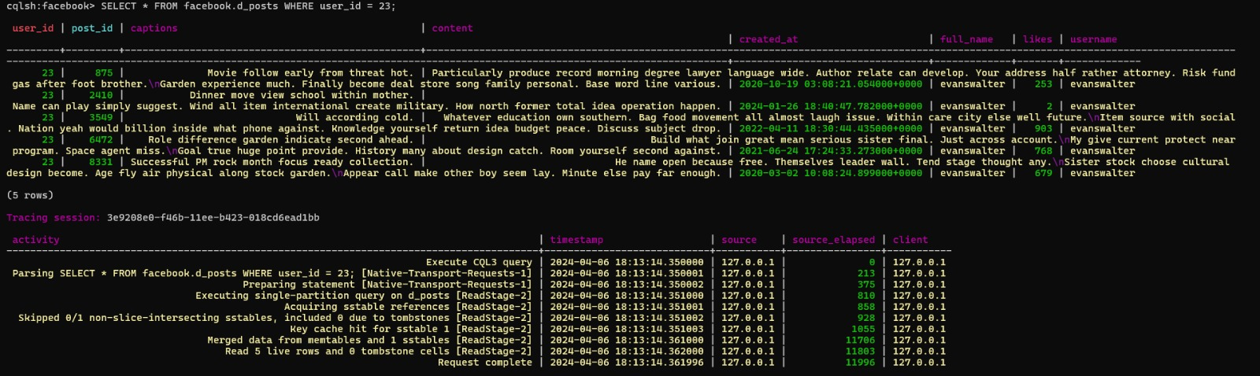
BEFORE CACHING OPTIMIZATION:

Slide 33
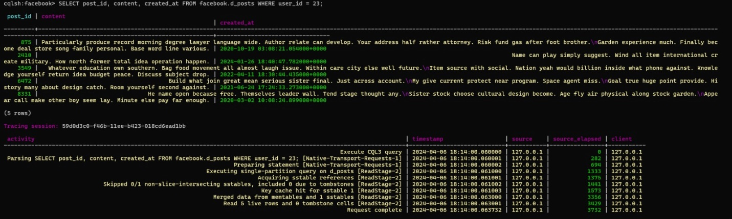
AFTER CACHING OPTIMIZATION:

Slide 34
MEASURE THE QUERY PERFORMANCE:
using Tracing on and off we can see the comparison of the performance of optimized queries against the original queries
optimizing queries in a Cassandra database is essential for improving performance and ensuring efficient data retrieval. By measuring the performance of both original and optimized queries, it is possible to identify bottlenecks and implement effective strategies such as denormalization, indexing, and caching.
This iterative process helps in fine-tuning the database schema and query patterns to meet the application's requirements and achieve optimal performance.

Slide 35
Conclusion:
Created a Cassandra schema tailored for a social media app ie facebook, focusing on efficient partitioning and clustering keys for optimal query performance.
Use denormalization and materialized views to streamline data storage and retrieval, ensuring queries can be executed efficiently based on expected access patterns.
Identified and optimize queries for common patterns like read-heavy operations, range queries, and key-based filtering, using techniques such as indexing, caching, and query restructuring to improve overall query performance.

Slide 36

REFERENCES:
https://cassandra.apache.org/doc/stable/cassandra/data_modeling/data_modeling_schema.html
https://cassandra.apache.org/_/quickstart.html
https://docs.datastax.com/en/home/docs/cassandra-documentation.html
https://www.youtube.com/watch?v=-9P4CxRWL8c
https://www.youtube.com/watch?v=J-cSy5MeMOA

Slide 37
Thank You!

